Slide 1

Major Project Review - II
Deep Learning Framework for Cervical Cancer Prediction and Personalized Health Recommendations using GenAI
Project Batch No : D5
Submitted By:
-B . Sireesha(22B01A4603)
-B . Prasanna(22B01A4605)
-B . Lohitha(22B01A4607)
-G . Hemalatha(22B01A4616)
-V . Samatha(22B01A4651)
Guide:
Dr. N. Silpa
Asst professor, CSE
Department of Computer Science and Engineering
Shri Vishnu Engineering College for Women (A), Bhimavarm.
Academic Year: 2025 – 2026
1

Slide 2
Consolidated table showing the modifications
suggested and done from the Review-I
Aspect Reviewed | Suggestion Provided | Modification Implemented
Project Problem Statement | No changes suggested | Continued as originally defined
Objectives | No changes suggested | Retained original objectives
Methodology | No changes suggested | Proceeded with initial methodology
Architecture / Model plan | No changes suggested | No modifications needed
2

Slide 3
Abstract
Cervical cancer is one of the most common cancers among Indian women, making up around 18–20% of all female cancer cases. Although it is preventable and treatable when found early, many women face delays due to lack of awareness and limited access to healthcare.
The system utilizes advanced convolutional neural networks
InceptionV3, ResNet, and Xception for accurate image-based prediction of cervical cancer. The model achieving the highest accuracy is deployed for final predictions.
What makes our system unique is that after predicting the risk, it gives personalized health suggestions using Generative AI. This includes:
Custom exercise plans (via YouTube),
AI-generated diet charts, and
Recommendations of nearby gynecologists based on the user's location.
3

Slide 4
Literature Survey
References | Key Findings | Limitations | Contribution
1. Automated Segmentation of After-Loaded Metal Source Applicators in Cervical Cancer Treatment Using U-Net (2024) | • U-Net effectively segments metal applicators in CT images • Achieves high Dice score (up to 0.93) | • Small dataset size • Model lacks interpretability • Requires manual post-processing | Uses transfer learning with large pre-trained models (InceptionV3, ResNet,Xception) General-purpose DL classifiers that adapt across image types
2. A Novel Web Framework for Cervical Cancer Detection System (2024) | • Web-based ML system using UCI data • Random Forest achieved high accuracy (98.1%) | • Lacks personalized care recommendations • No post-diagnosis guidance • Not linked to real-time, location-aware services | Adds GenAI-based diet, exercise, and local doctor recommendations Transitions users from diagnosis to personalized wellness guidance
3. Multiscale Optical Imaging Fusion for Cervical Precancer Diagnosis (2023) | • Fusion of colposcopy + HRME improves lesion detection • Deep CNN (MSFN) achieved 0.91 AUC • Good lesion localization in CIN2+ patients | • No prevention or post-diagnosis pathway • Hardware (colposcope + HRME) is expensive and not suitable for low-resource clinics | Emphasizes early-stage screening through scalable image classification, not hardware-dependent
4. Deep Learning in Cervical Cancer Diagnosis: Architecture, Opportunities, and Challenges (2023) | • High classification accuracy (up to 99.5%) • DL works well on Pap, HPV, and colposcopy images | • Overfitting due to small datasets • Lack of personalization • No support system post-prediction • Generic models lack Indian-context adaptability | Uses ensemble DL models to reduce overfitting Framework is tailored for Indian women using contextual health variables Adds a personal health support layer after prediction
5. Deep-learning models for image-based gynecological cancer diagnosis: a systematic review and meta-analysis (2024) | • Reviewed 48 studies on DL-based diagnosis of cervical, ovarian, endometrial, vulvar, and vaginal cancers. • Identified CNN-based models like ResNet, VGGNet, UNet as most commonly used. • DL methods outperformed ML in sensitivity (DL: 89.4%, ML: 34.6%). | • High heterogeneity in data sources, image modalities, and model validation. • Limited real-world deployment or comparison with human experts. • Focused only on diagnosis — no post-diagnosis support or personalization. • Lack of localization for specific populations like Indian women. | Focuses on Indian women’s healthcare: bridging technology with local accessibility. Offers end-to-end solution: from detection ➝ to personalized care and wellness.
4

Slide 5
Problem Statement
Cervical cancer remains a leading cause of death among Indian women due to delayed diagnosis caused by limited awareness and healthcare access. Manual examination of cervical cell images is time-consuming, inconsistent, and error-prone due to subtle morphological differences between cell types.
To address this, we aim to develop an automated, deep learning-based system using CNN models like InceptionV3, ResNet, and Xception for accurate classification of cervical cells. By ensuring consistency and enabling early detection, the system supports doctors in making faster and more reliable diagnoses.
Additionally, we integrate Generative AI to provide personalized health suggestions, including exercise plans, AI-generated diet charts, and location-based gynecologist recommendations.
5

Slide 6
Research Objectives
To collect a diverse and representative dataset of cervical cell images and patient records, focusing on the Indian demographic context.
To apply preprocessing techniques such as normalization, augmentation, and noise reduction to improve image input quality.
To train multiple CNN models (InceptionV3, ResNet, Xception) and select the best-performing model based on accuracy and robustness.
To test the selected deep learning model using validation and test sets for generalization and reliability.
To integrate a GenAI-based recommendation system that provides personalized guidance on exercise, diet, and nearby gynecologists based on prediction results.
6

Slide 7
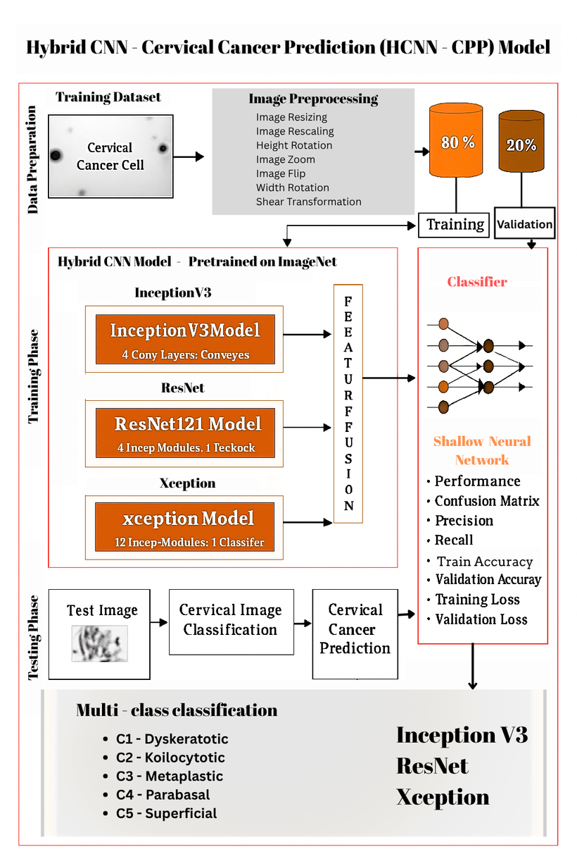
Finalized Proposed Solution
7

Slide 8
Detailed Methodology
Dataset Acquisition – Cervical cell images from Kaggle & Indian context datasets.
Preprocessing – Normalization, noise reduction, augmentation, resizing.
Model Training – InceptionV3, ResNet, Xception architectures compared.
Model Selection – Highest accuracy model chosen for final system.
Evaluation – Confusion matrix, precision, recall, F1-score.
GenAI Integration – Personalized lifestyle and medical guidance
8

Slide 9
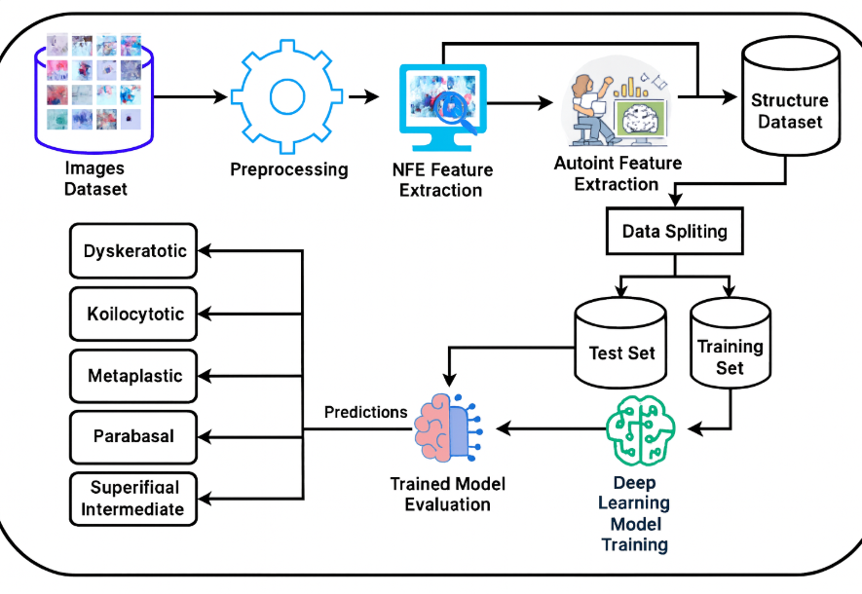
Detailed Methodology
9

Slide 10
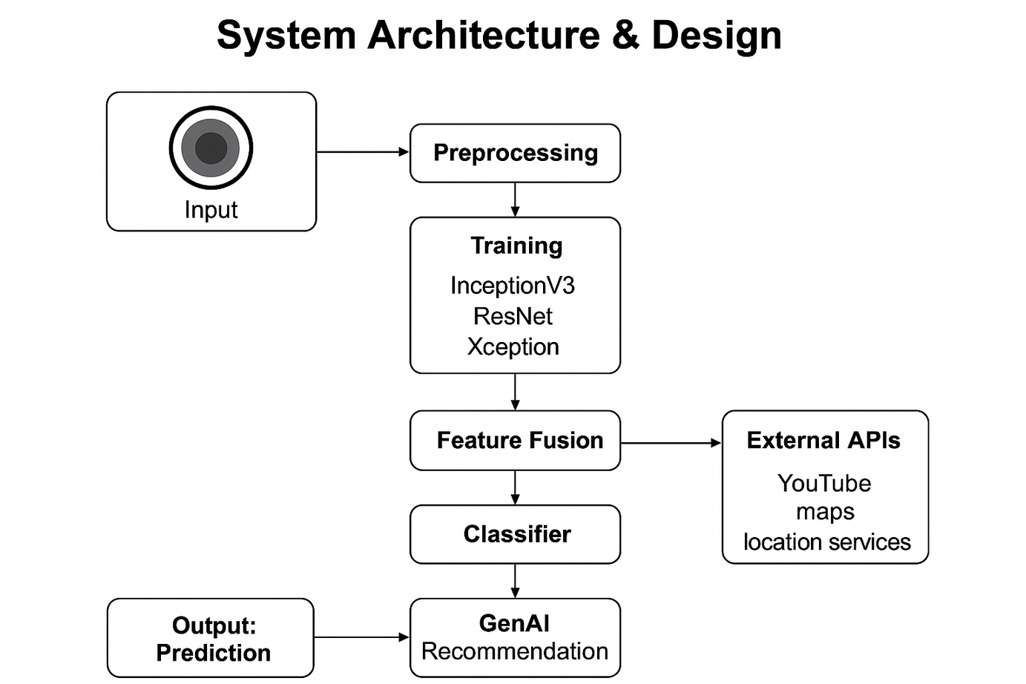
System Architecture and Design
10

Slide 11
System Modules
Data Collection and Image Preprocessing Module
Model Training Module
Model Testing & Prediction Module
GenAI Recommendation Module
11

Slide 12
1. Data Collection and Image Preprocessing Module
Dataset Cervical cell images collected from trusted open-source datasets (e.g., SIPaKMeD, Kaggle).
Images include multiple cervical cell types: Dyskeratotic, Koilocytotic, Metaplastic, Parabasal, Superficial.
Data Cleaning Removal of blurred, duplicate, or low-quality images. Manual verification to ensure class balance and clarity.
Image Preprocessing Resizing to fixed dimensions for model compatibility. Rescaling (normalization) to stabilize training.
Augmentation (rotation, zoom, shift, shear) to improve generalization.
Output of This Module High-quality, preprocessed images ready for model training. Balanced dataset ensuring consistent learning.
12

Slide 13
2. Model Training Module
Hybrid CNN Approach Three pretrained CNN architectures used for powerful feature extraction:
InceptionV3 – handles multi-scale feature learning.
ResNet121 – strong residual connections, avoids vanishing gradients.
Xception – depth wise separable convolutions for efficient learning.
Training Procedure Input preprocessed images → pass through each CNN. Extract deep feature vectors from each model.
Feature Fusion: Combine feature outputs to create a rich hybrid representation. Train a Shallow Neural Network classifier for final prediction.
Output of This ModuleA trained Hybrid-CNN model capable of accurate cervical cancer classification.
13

Slide 14
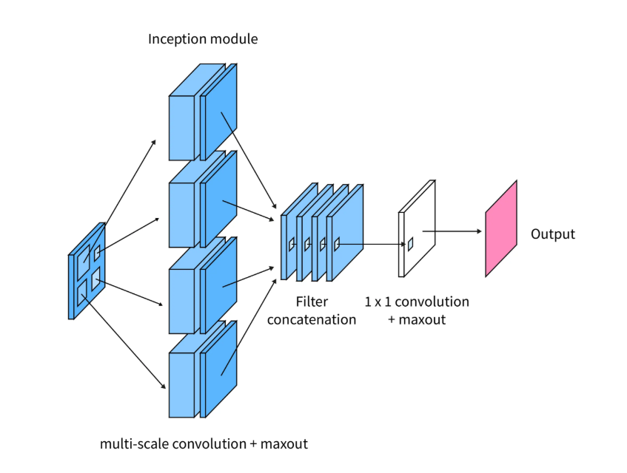
Inception V3 Model
Purpose: Extracts multi-scale features efficiently for image classification.
Key Features:
Uses Inception modules to process multiple filter sizes in parallel.
Reduces computational cost with factorized convolutions.
Deep architecture suitable for high-resolution images.
Use in Project: Detects subtle differences in cervical cell images across classes.
14

Slide 15
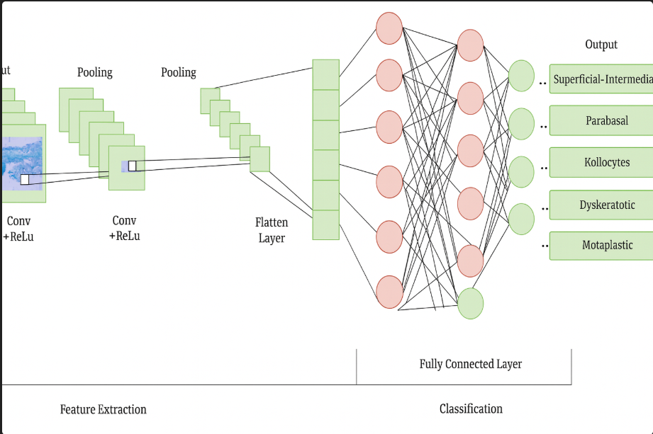
ResNet (Residual Network)Model
Purpose: Enables training of very deep networks without vanishing gradients.
Key Features:
Residual connections skip layers to prevent gradient loss.
Versions: ResNet-50, ResNet-101 (depth varies).
Excellent for extracting complex hierarchical features.
Use in Project: Captures detailed patterns in cells for accurate cancer stage detection.
15

Slide 16
Xception Model
Purpose: Xception is designed to build efficient and powerful deep CNNs using depth wise separable convolutions, enabling high performance with reduced computational cost.
Key Features:
Depth wise Separable Convolutions
Splits convolution into spatial and channel-wise operations, making it more efficient than traditional CNNs.
Lightweight & Fast
Offers high accuracy while reducing parameters and memory usage.
Better Feature Extraction
Excels at capturing fine-grained textures, shapes, and structural patterns in images.
Use in Our Project:
Enhances cervical cell image analysis by identifying subtle texture variations, cell boundaries, and morphological changes crucial for accurate cancer stage detection.
16

Slide 17
3. Model Testing & Performance Validation
Testing Workflow
Input test image → preprocessing → Hybrid-CNN → class prediction Multi-class
output categories: Dyskeratotic, Koilocytotic, Metaplastic, Parabasal, Superficial.
Performance Evaluation Metrics
Accuracy – overall correctness of predictions
Precision – correctness of positive predictions.
Recall (Sensitivity) – ability to detect cancerous classes correctly
F1-Score – balance between precision & recall
Confusion Matrix – evaluates class-wise performance Training
Validation Curves – monitors model learning quality.
Outcome Reliable and explainable predictions suitable for medical support systems.
17

Slide 18
4. Gen AI Health Recommendation Module
Integration of GenAI receives model prediction + user symptoms. Generates personalized medical and lifestyle guidance.
Recommendation Outputs Cancer Stage Suggestion Using symptoms + model confidence scores.
Diet Recommendations AI-generated customized diet chart supporting cervical health.
Exercise / YouTube Video Recommendations Curated routines appropriate for the predicted condition.
Nearby Gynecologist Suggestions Location-based guidance for further medical consultation.
Importance of GenAI Module Bridges the gap between screening and actionable health management. Helps patients with immediate next steps. Adds value beyond traditional ML systems by enabling personalized care.
18

Slide 19
Plan of Action for Review-III
Train All Selected CNN Models:
Train InceptionV3, ResNet, and Xception using the preprocessed dataset.
Apply transfer learning with ImageNet weights for efficient convergence.
Monitor training and validation performance for each model.
Evaluate Model Performance Compare models using:
Key metrics: Accuracy, Precision, Recall, F1Score and Confusion Matrix, Check training/validation loss curves to detect overfitting.
Select the Best Performing Model Identify the model with the highest overall classification performance. Validate best model on unseen test images for reliability. Document strengths and limitations of each model.
19

Slide 20
References
Hybrid Vision Transformer with Ensemble CNN for Cervical Cancer Diagnosis, BMC Medical Informatics, 2025.
Automatic Cervical Cell Classification Using Improved DenseNet121, Scientific Reports (Nature), 2025.
Deep Learning Approaches for Cervical Cancer Diagnosis, European Journal of Gynaecological Oncology, 2025.
Cervical Cancer Classification Using Deep Learning on Colposcopy Images, Neural Processing Letters, Springer, 2025.
Nuclei Segmentation Techniques in Cervical Smear Images: A Review, Artificial Intelligence Review, Springer, 2025..
20

Slide 21
Contributions by Each Team Member
B. Sireesha - Collected cervical cell datasets and performed preprocessing steps (normalization, resizing).Helped prepare the abstract, problem statement, and literature survey content.
2. B. Prasanna - Studied related research papers and documented deep-learning techniques used. Assisted in preprocessing and organizing dataset structure.
3. B. Lohitha - Compared CNN models (InceptionV3, ResNet, Xception) and supported model selection. Helped prepare methodology content and evaluation plan.
4. G. Hemalatha - Designed system workflow, architecture diagrams, and PPT slide structure. Organized methodology flow and supported content refinement.
5. V. Samatha - Compiled review materials and structured final PPT formatting.
Assisted in literature survey, documentation writing, and slide preparation.
20

